Slide 1
Clean - Drain - Dry
Legislation and Regulations
* TEMPLATE WILL BE AVAILABLE ONLINE PRIOR TO 2017 TRAINING SEASON

Slide 2
Presentation Outline:
History of Aquatic Invasive Species Regulations
Regulatory Efforts
Permits
Exemptions
Standardizing Programs & Importance
Stewards Role
Frequently Asked Questions

Slide 3
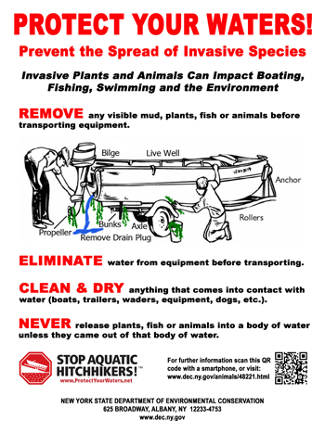
Regulatory Efforts
Amendment to Article 3 of the Navigation Law
“AIS spread prevention signs at all public boat launches”
6 NYVRR Part 59.4 (NYSDEC)
& 9 NYCRR Part 377.1 (NYSOPRHP)
“AIS spread prevention regulations for boat launching/retrieving at DEC and Parks-owned sites”

