Slide 1
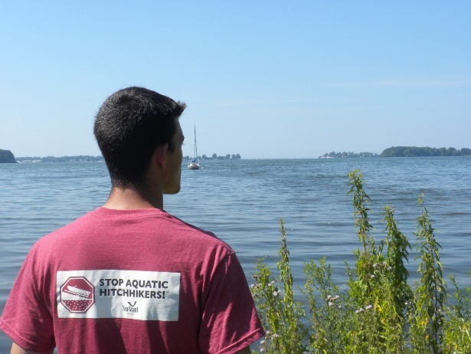
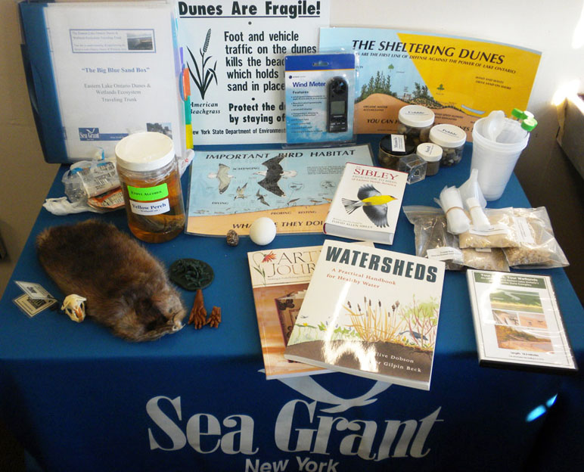
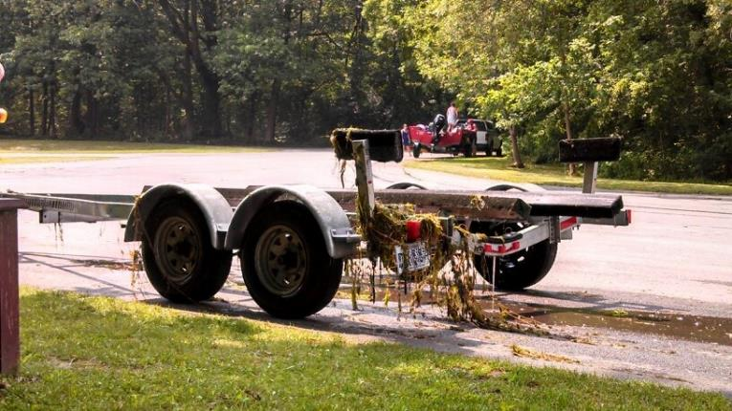
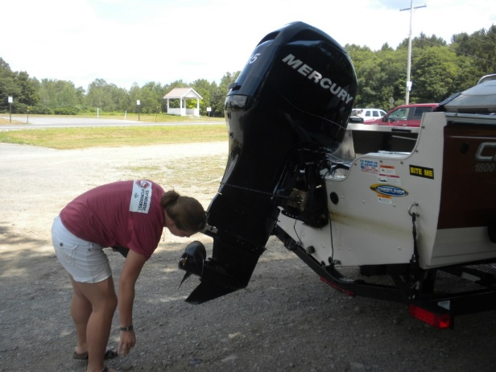
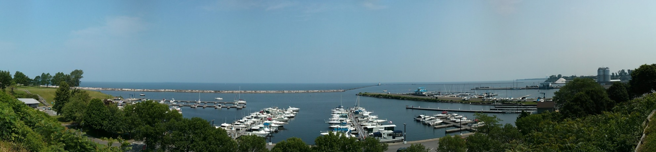
Invasive Species
Fighting the Frontlines to Prevent the Spread
Notes:
Photo by New York Sea Grant

Slide 2
Presentation Outline
What are Aquatic Invasive Species?
Characteristics and Concerns
Why should the public care?
Strategies for management
Species Examples
Specimen Collection Protocol
Additional Resources

Slide 3
Aquatic Invasive Species
Aquatic organisms (plants, animals, and pathogens) that are not native to the aquatic ecosystem under consideration and whose introduction causes or is likely to cause economic or environmental harm or harm to human health.
Pathway of Introduction
Vectors include aquarium trade, hiking, boating, swimming, fishing
Seeds, plant parts or larvae attached on boots, waders, clothing, automobiles, recreational and commercial boats, paddles, lifejackets, bilge water
Recreational boating… a key pathway in the spread of AIS.
Notes:
The New York State Invasive Species Task Force defines AIS as aquatic organisms (plants, animals, and pathogens) that are not native to the aquatic ecosystem under consideration and whose introduction causes or is likely to cause economic or environmental harm or harm to human health.
There are many vectors which aid in the introduction of invasive species.
Recreational boating is identified as a key pathway in the spread of aquatic invasive species across the Great Lakes Basin including inland waterbodies.

Slide 4
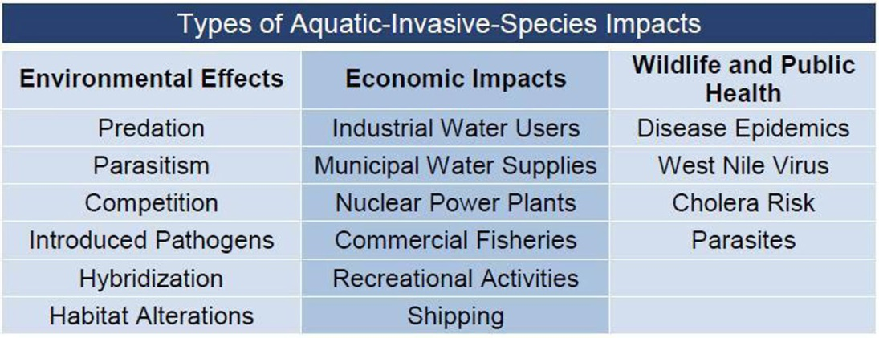
Aquatic Invasive Species Characteristics
Aggressively outcompetes native species
Often provides little to no nutritional value
Free from native predators
High fecundity
Reasons to be concerned:
Ecology
Recreation
Economics
Health
Notes:
There are four major Reasons to Be Concerned About AIS
Ecologically : AIS can out-compete and displace native species, disrupting food webs and altering native aquatic species population abundance and composition. These ecosystem changes may make once suitable habitat less favorable for native aquatic animals such as sport fish and macro invertebrates.
Economically: The federal, state, and local costs to manage AIS increase each year as populations continue to grow and spread.
Recreationally: Aquatic invasive plants can form dense mats of vegetation, making it difficult or impossible to boat, swim, or fish. Species such as spiny and fishhook waterfleas are a nuisance to anglers. Zebra mussels can cut the feet of swimmers and encrust historic shipwrecks.
Health-wise: AIS can carry pathogens and parasites that are harmful to native species and potentially to human health. Zebra and quagga mussels likely play an important role in transmitting type E Botulism. type E Botulism is a bacterial disease that has caused die offs in fish and waterfowl.
There are things that we can do to limit the spread of AIS… For example Developing watercraft inspection programs to intercept the introduction of AIS, Educating boaters on how they can help prevent the spread of AIS and by Inspecting and Following the Clean Drain Dry Campaign

Slide 5
Why should the public care?
Invasive species almost always out-compete, damage or displace native species.
Invasive species are a factor in the decline of 49% of all threatened or endangered species.
The economic impact of invasive species in the U.S. is estimated over $120 billion annually.
Invasive species reduce agricultural crop yields and increase agricultural expenses.
Invasive species may increase human exposure to health risks such as Polychlorinated biphenyls (PCBs), cholera bacteria and other viruses.
Notes:
Stewards are often asked by the public “why should we care” here are some examples that stewards can use to explain.
Why Should We Care about Aquatic Invasive Species?
Environmental Effects
The impacts of invasive species are second only to habitat destruction as
a cause of global biodiversity loss. In fact, introduced species are a
greater threat to native biodiversity than pollution, harvest, and disease
combined. AIS impact the habitats they invade by reducing the
abundance of native species and altering ecosystem processes. They
impact native species through predation, competition for food and space,
hybridization, as well as the introduction of harmful pathogens and
parasites. AIS may also alter normal functioning of the ecosystem by
altering fire regimes, hydrology, nutrient cycling and productivity.
Economic Impacts
AIS are seen as a threat not only to biodiversity and ecosystem
functioning, but also to economic development. They reduce production
of fisheries, decrease water availability, block transport routes, choke
irrigation canals, foul industrial pipelines, degrade water quality, accelerate filling of lakes and reservoirs, and decrease
property values. Through damage to human enterprises, invasive species inflict an enormous economic cost; the cost to
manage both aquatic and terrestrial species is estimated at $137 billion per year to the U.S. economy alone. This number
is likely an underestimate as it does not consider ecosystem health or the aesthetic value of nature, which can influence
tourism and recreational revenue. Estimating the economic impacts associated with AIS is further confounded as
monetary values cannot be given to extinction of species or loss biodiversity and ecosystem services.
Public Health
Throughout recorded history, epidemics such as malaria, yellow fever, typhus, and bubonic plague have used introduced
organisms as vectors and reservoirs. More recently, West Nile virus was introduced into the United States through an
infected bird or mosquito. Waterborne disease agents, such as cholera bacteria (Vibrio cholerae), and causative agents of
harmful algal blooms are often transported in the ballast water of ships. The effect of AIS on public health extends beyond
the immediate effects of disease and parasites as chemicals used to control invasive species can pollute soil and water.
Other AIS, such as invasive mussels, may increase human and wildlife exposure to organic pollutants such as
Polychlorinated biphenyls (PCBs) and Polycyclic aromatic hydrocarbons (PAHs) as these toxins accumulate in there
tissues and are passed up the food chain.
Information derived from NOAA Aquatic Invasive Species information sheet (http://www.habitat.noaa.gov/pdf/best_management_practices/fact_sheets/Aquatic%20Invasive%20Species%20Overview.pdf)

Slide 6
Notes:
Guidance for invasive plant species management can be found in the Nature Conservancy’s Invasive Plant Management Decision Analysis Tool (IPMDAT) at http://www.imapinvasives.org/IPMDAT_v1.1_06-30-11.pdf or at http://www.imapinvasives.org/ipmdat.html
http://www.gao.gov/assets/680/673897.pdf

Slide 7
Typical Strategies for Invasive Species Management
Prevention: Prevent the introduction of new invasive species
Early Detection/ Rapid Response: Rapidly detect new and recent invaders and eliminate all individuals within a specific area
Cooperation: Share resources, including funding personnel, equipment, information and expertise
Information Management: Collect, utilize and share information regarding surveys, infestations, control methods, monitoring and research
Control: Control populations of invasives using containment, suppression and eradication strategies
Restoration: Develop and implement effective restoration methods for areas that have been degraded by invasive species
Education/Outreach: Increase public awareness and understanding of invasive species issues
Notes:
These are 7 strategies for invasive species management that can be applied to various management initiatives.
It is important to think of Prevention as the first line of defense when implementing management strategies against invasives because once an invasive species is introduced into an area it is difficult and often costly to manage.
Early Detection/ Rapid Response are key components to any invasive species management strategy. SLELO PRISM focuses our efforts in what we call Priority Conservation Areas (PCAs) and Highly Probable Areas (HPAs) which will be discussed in the next slide
The rest of the strategies include: Cooperation, Information Management, Control, Restoration, Education & Outreach

Slide 8
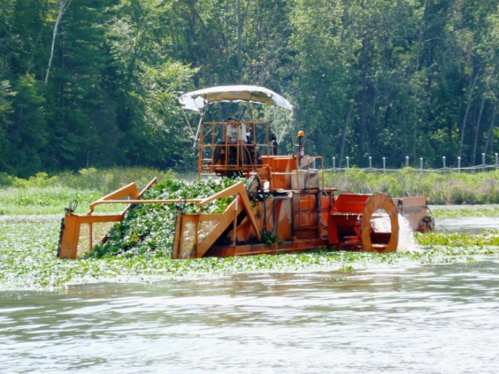
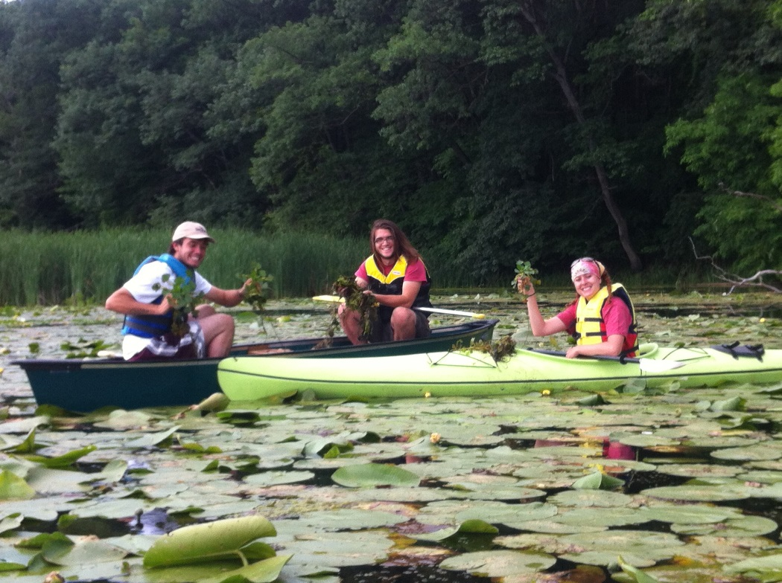
Control & Methods
Basic Levels of Control
Eradication
Containment
Suppression
Control Methods
Physical
Mechanical
Chemical application (all require permits)
Biological
Notes:
Management of invasive species involves using 3 basic levels of control:
Eradication which is to eliminate all individuals of a target population and or seed bank; this level of control is often not feasible for both technical and financial reasons, and is only considered successful after observing no invasive regrowth for 3 consecutive years.
Containment involves reducing or, if possible, completely preventing the dispersal of an already established population into new locations. This method is often used to prevent the spread of an invader into Priority Conservation Areas (PCA’s) when stable populations are known to be nearby or adjacent;
Suppression which reduces the density of a target population below a certain threshold to maintain native species or a desired ecological process. This strategy may not necessarily include the total area or boundary of established infections, and is often used in conjunction with containment when infestations are widespread or beyond the scope of eradication and rapid-response methods.
The three basic levels of control can be implemented using different control methods such as: physical control like hand pulling, mechanical control which involves using machinery, chemical application of insecticides & herbicides; and biological control which involves the use of a natural predator or competitor to control populations of a target species.
Photo by New York Sea Grant

Slide 9
Notes:
include speaking notes on specific aquatic invasive species to be discussed during presentation
Native Range/ Introduction:
Identification:
Impacts:
Spread:
Control:

Slide 10
Asian Clam (Corbicula fluminea)
Native Range/ Introduction:
Asia/Intentional importation
Impacts:
Damages the water systems of electrical/nuclear power plants and industrial water systems, Competes with native species for resources
Suggested Control:
Watercraft inspection to remove hitchhiking organisms and prevent spread, pressurized washing, molluscicides and benthic barriers in small areas can be effective.
Notes:
Native Range/Introduction:
Native to Asia, Asian clams were likely introduced to the West Coast of North America around 1930, initially assumed to have been imported as a food source for the immigrating Chinese population or it may have come in with the importation of the Giant Pacific oyster also from the Asia. Live Asian clams were first detected in US waters in 1938 in the Columbia River, in Washington; the species quickly spread across the continent and are currently found in 44 states. In New York State, shells of the Asian clam have been collected in the running waters of central and western portions of the state.
Identification:
Asian clam have a small light brown to yellow-colored bivalve with distinctive radial lines and brown/purple colored radial bands on the underside of the shell.
Impacts
Asian clam is notorious as a biofouler of electrical and nuclear power plants and industrial water systems. It has also been documented to cause problems in irrigation canals, pipes and drinking water supplies. In addition, it alters water body substrates, and competes with native species for resources.
Spread:
The exact mechanism for secondary dispersal of Asian clam throughout North America is unknown, but likely involves human activity, including bait bucket introductions, accidental introductions associated with imported aquaculture species, and intentional introductions by people who buy them as a food item in markets . Furthermore, Larval clams can attach to vegetation, and floating debris for long distance dispersal.
Control:
Prevention of the transport of Asian clam is the most effective. Mollusks can be removed from piping through pressurized washing. Molluscicides and benthic barriers best for small areas; effectiveness is molluscicides in open areas is limited and benthic barrier use for infestations larger than 1 acre not recommended
Photo Asian Clam: Crown Copyright 2009 - GB Non-Native Species Secretariat

Slide 11
Bloody Red Shrimp (Hemimysis anomala)
Native Range/Introduction:
Europe and western Asia/Ballast water
Ecological Impacts:
Currently, the impacts of Hemimysis are not well understood. However, because they feed on plankton and insect larvae, there could be impacts on the native food chain. Specifically, food availability may be reduced for young native fishes.
Suggested Control:
Watercraft inspection to remove hitchhiking organisms and prevent spread
Notes:
Native Range/Introduction:
Hemimysis or bloody red shrimp, are an invasive crustacean native to freshwater areas in Europe and western Asia. It has been identified in all of the Great Lakes except for Lake Superior and was likely brought here by the ballast water of ships. The first sighting of this species in Lake Ontario was in 2006. Later that year the shrimp were found near Oswego, New York. Populations of this species grow quickly and can be found at high densities; 500 shrimp per cubic meter in some locations.
Identification:
Mature bloody red shrimp are 6-13mm long with a yellowish or translucent color with red pigmentation on their dorsal and posterior section, and a long double pointed spine. Groups of bloody red shrimp form red colored swarms along the shadowed edges of piers, boats or shorelines.
Impacts
Currently, the impacts of bloody red shrimp are not well understood. However, because they feed on plankton and insect larvae, it is believed that bloody red shrimp could cause negative impacts on the native food chain. Specifically, food availability may be reduced for young native fishes.
Control:
Prevention is the best control method and can be implemented by practicing the Clean, Drain, Dry protocol when entering/leaving a new body of water.

Slide 12
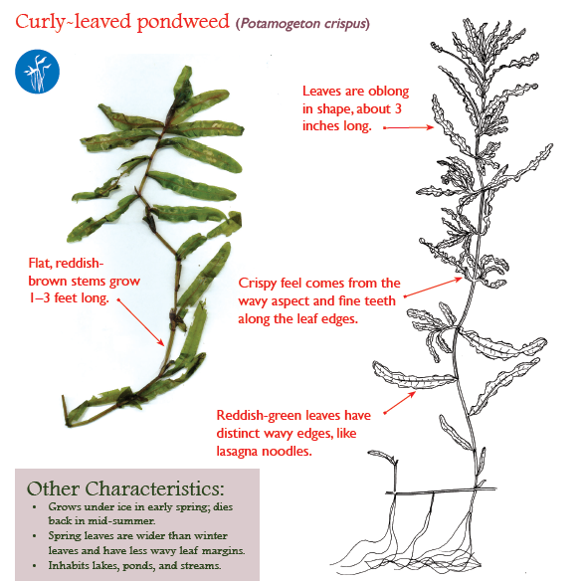
Curly-leaf Pondweed (Potamogeton crispus)
Native Range/Introduction
Europe, Africa, Australia
Ecological Threat
New plants form under ice cover during late winter, one of the first plants to emerge in early summer. Possible loss of oxygen from plant die-offs in midsummer
Suggested Control:
Physical, mechanical, or chemical techniques, many native look-alikes

Slide 13
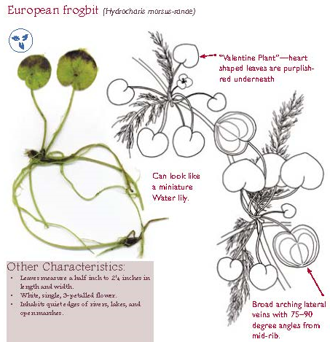
European Frog Bit (Hydrocharis morsus-ranae)
Native Range/Introduction
Found in temperate regions of Eurasia, First observed in NY: 1974
Ecological Threat:
Rapid vegetative spread and forms dense mats, which can limit light penetration and inhibit recreational use
Suggested Control:
Limited information exists about control techniques for this species. Hand pulling may be suitable to control individual plants or small infestations.

Slide 14
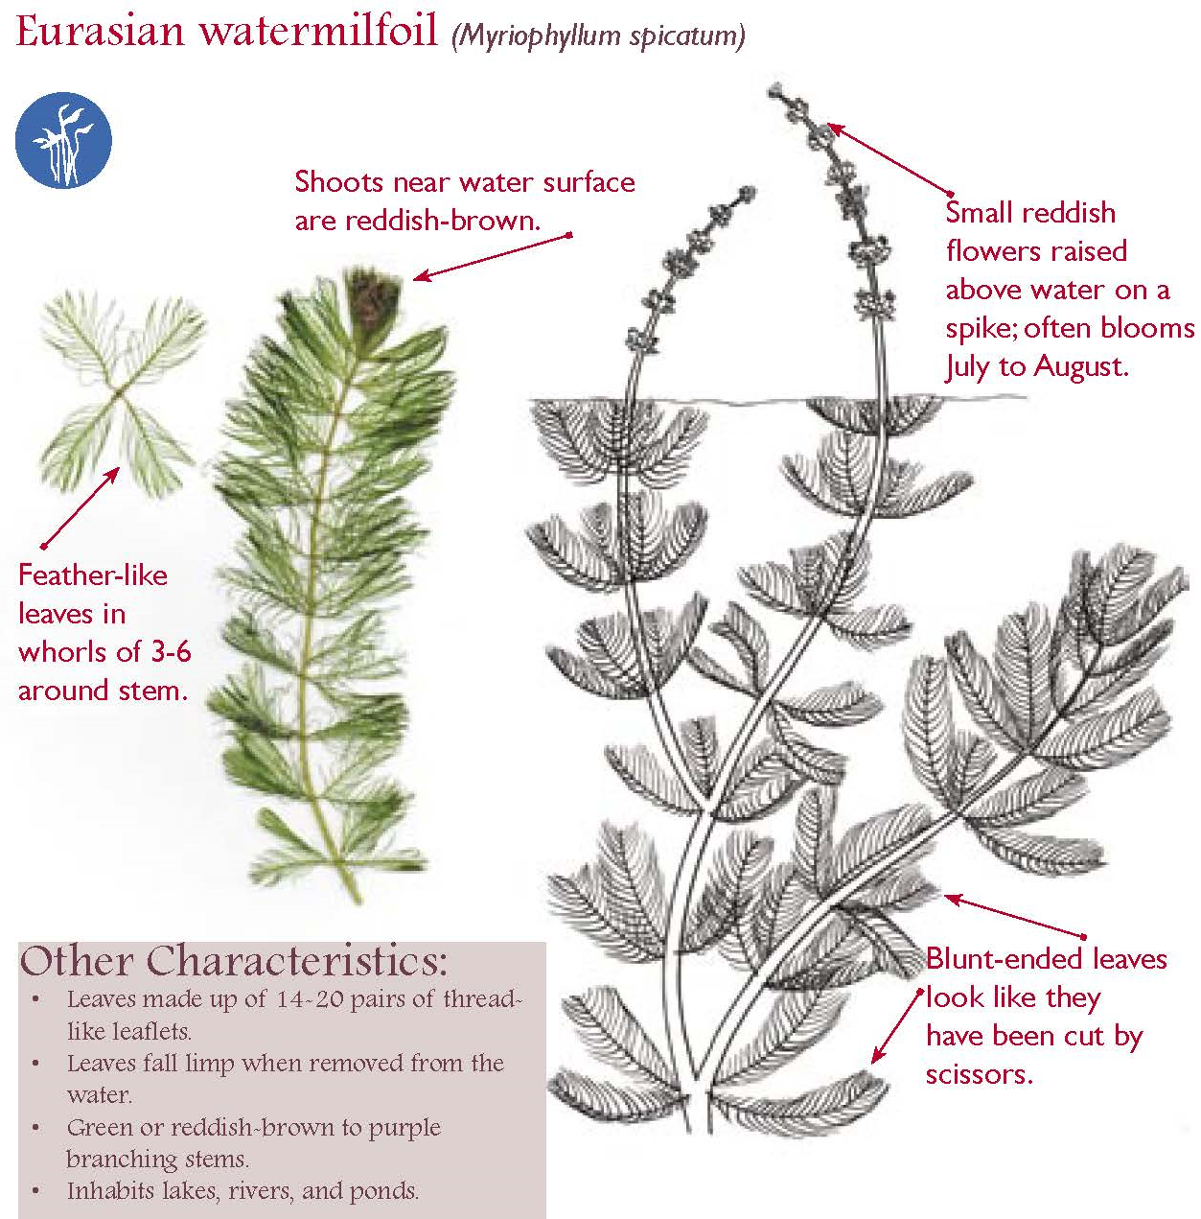
Eurasian Watermilfoil (Myriophyllum spicatum)
Native Range/ Introduction
Europe, Asia/ Accidental
Ecological Threat:
Monocultures; Fragmentation, “Dead zones” due to plant die offs, Clogs water ways and impairs recreational activities, Causes high recreation-oriented financial losses and lowered property values.
Suggested Control:
A variety of control methods used nationwide to manage; Hand-pulling; benthic barriers; aquatic herbicides (with permit) and biological controls.
Notes:
Native Range/Habitat:
Eurasian watermilfoil is a submerged aquatic plant that is native to Eurasia and northern Africa. It occupies water 3 – 12’ deep, growing best in fertile, fine texture, inorganic sediments. It prefers highly disturbed and heavily used nutrient rich lake beds. It is also found in ponds, slow moving streams, reservoirs, and estuaries. It is not successful in undisturbed areas where native plants are well established.
Introduction:
Eurasian watermilfoil is believed to have been accidentally introduced to North America during the late 1800’s, with an initial introduction in northeastern parts of the US, Eurasian watermilfoil is widely distributed throughout the country, as well as regions of Canada. It is listed as a noxious or otherwise restricted plant in 17 states (in NYS Eurasian watermilfoil is classified as "prohibited").
Identification:
There are many native milfoil species in North America; Eurasian watermilfoil can be identified by a few characteristics. It is a submerged aquatic plant with a terminal leader that is reddish-brown in color; it has 4-5 leaves with 9-21 feathery leaflet pairs whorled around the stem that are limp when out of water. Native milfoil species have 5 to 10 leaflet pairs which remain rigid when out of the water
Impacts:
Eurasian watermilfoil has the ability to overwinter and grow rapidly in the spring, blocking out sunlight needed by native plants. It also reduces the biodiversity and abundance of native plants and aquatic wildlife particularly macroinvertebrate and native fish populations. Loss of such species reduces the ecological value and benefits that aquatic ecosystems have to offer.
Spread:
Although Eurasian watermilfoil produces seed, plant fragmentation is believed to be the most common mode of spread in North America. Milfoil can be easily spread in a waterbody by boats, trailers and other machinery, as well as, water currents. milfoil is spread overland mostly by human intervention (particularly as a hitchhiker on recreational boats, harvesters, and other aquatic machinery)
Control:
Hand-pulling is the best method for small infestations. Raking is also an option. All plant fragments must be removed from the water and shoreline to prevent spreading the infestation. Benthic barriers(sheets of materials, attached to a lake bottom) can be used locally around docks and prevent plant growth by blocking sunlight.
Chemical application of aquatic herbicides are the most commonly used chemicals against milfoil. However, both of these have mixed results and can affect native plant populations.
Milfoil can also be controlled biologically; researchers have found a native North American weevil that feeds on Eurasian water-milfoil, but this method also has mixed results

Slide 15
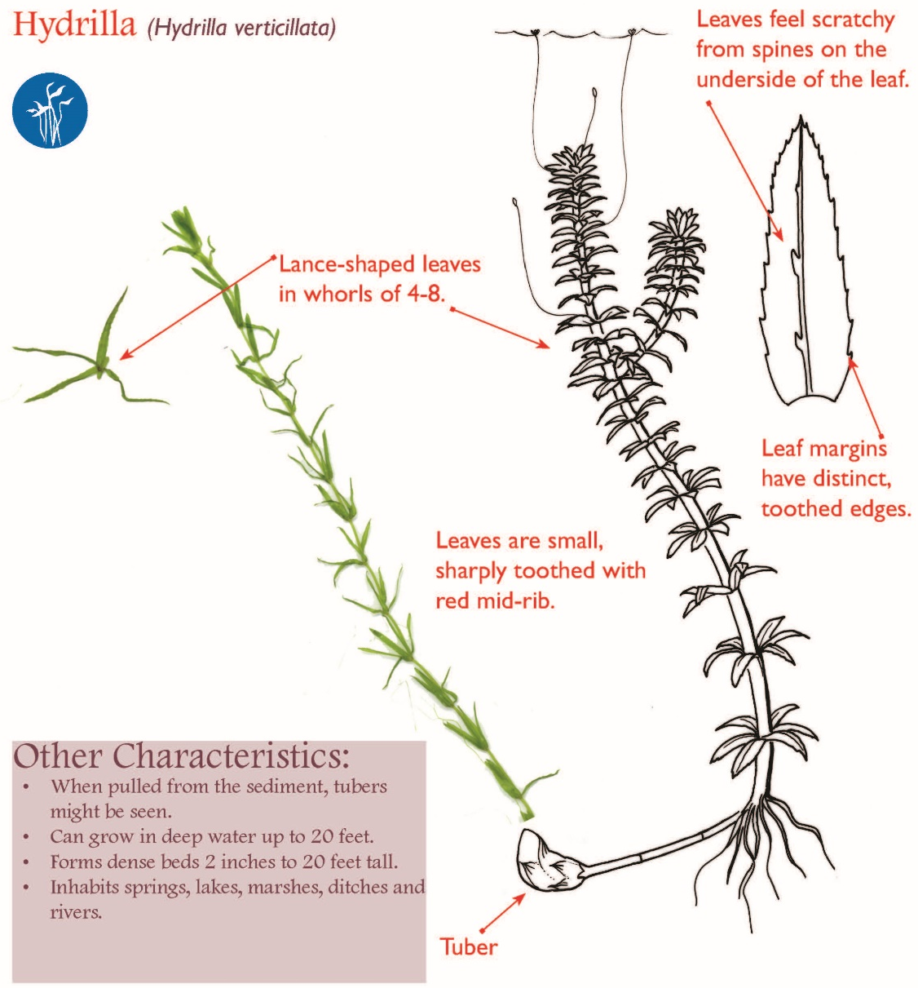
Hydrilla (Hydrilla verticillata)
Native Range/ Introduction:
Indian subcontinent, Korea/Imported
Ecological Threat:
Aggressively spreads and dominates native, beneficial, aquatic plants. Renders surface waters unusable for recreation and fishing. Winter dieback may reduce dissolved oxygen levels.
Suggested Control:
Herbicide release or injection of herbicide below the surface of the water are common control methods for Hydrilla. Mechanical harvesting of Hydrilla is not recommended because fragmentation can contribute to spread.
Notes:
Native Range/Introduction:
There are two different reproductive types of Hydrilla; one type has female flowers, while the other has both male and female flowers on the same plant.
Hydrilla plants with only female flowers are believed to originate from the Indian subcontinent, whereas hydrilla plants with both female and male flowers are believed to be from Korea.
Southern populations are predominantly plants that have only female flowers that overwinter as perennials. Populations north of South Carolina, including populations in New York, have both male and female flowers on the same plant that set some fertile seed, and depend on tubers for overwintering.
Identification:
Hydrilla is a submerged aquatic plant that roots in the bed of a waterbody. It has long stems (up to 25 feet in length) that branch at the surface where growth becomes horizontal and forms dense mats. Leaves are small (2 - 4 mm wide, 6 - 20 mm long), pointed, often serrated and arranged around the stem in whorls of 4 to 10. It can be distinguished from its native look alike elodea which has only 3 leaves per whorl and no serrations.
Impacts:
Hydrilla is one of the world’s worst aquatic invasive plants. It invades deep, dark waters where most native plants can’t grow. Its stems can grow up to an inch a day reaching 20-30 feet. It blocks out sunlight and suppresses native vegetation. Major hydrilla colonies can alter the physical and chemical characteristics of lakes and deter recreational activities and reduce lakeshore property values.
Spread:
The main means of introduction of Hydrilla is as castaway fragments on recreational boats and trailers and in their live wells. New colonies can often be found near boat ramps as such stem pieces become rooted in the substrate (even very, very small fragments can become the start of new populations). Boat traffic through established populations can shatter and spread Hydrilla throughout the waterbody, similar to the spread of Eurasian watermilfoil.
Control:
Herbicide spraying and injections below surface of water are common control methods of controlling Hydrilla. Both are expensive and only moderately effective. Mechanical harvesting of Hydrilla is not recommended because fragmentation can contribute to spread.

Slide 16
New Zealand Mud Snail (Potamopyrgus antipodarum)
Native Range/Introduction:
Mollusk native to New Zealand. Introduced to Great Lakes via ballast water of ships.
Ecological Impacts:
Out-competes native snail species, Reduces biodiversity, Alters nutrient flows, Damage piping of power and water facilities
Suggested Control:
Watercraft inspection to remove hitchhiking organisms and prevent spread, clean waders and biological control agents
Notes:
Native Range/Introduction:
The New Zealand mud snail is native to New Zealand and was introduced to the Great Lakes Via ballast water
It was first discovered in Idaho in 1987. Being that a single snail can produce approximately 230 young per year, they have spread rapidly since. Interestingly, all introduced populations in North America are clonal, meaning they are all genetically identical females.
Impacts
This species can be found in many types of aquatic habitats. They feed on dead and dying plant and animal material, algae, and bacteria. They out compete other native snail species, reducing biodiversity. Populations can persist at very high densities which alter nutrient flows and they have the potential to clog pipes of power and water facilities.
Best Control is prevention by keeping boats and equipment clean. Use of trematode parasites have been used as a biological control agent.
Photo New Zealand Mud Snail: Michal Manas, Wikimedia Commons; New York State Prohibited and Regulated Invasive Animals

Slide 17
Rusty Crayfish (Orconectes rusticus)
Native Range/Introduction:
This freshwater crayfish is thought to be native to the Ohio River Basin.
Ecological Impacts:
Causes severe changes to the aquatic food chain, displace native crayfish species, reduce aquatic plant diversity and abundance, reduces shelter and food for young game fish and aquatic invertebrates
Suggested Control:
Purchasing native bait and properly disposing unused bait. Do not dump unused bait in the waterways.
Notes:
Native Range/Introduction:
Rusty crayfish are an aggressive species with the ability to alter the aquatic food chain in non-native ecosystems. Thought to be native to the Ohio River Basin, the rusty crayfish was likely introduced by fisherman who dumped their leftover bait into waterways.
Identification:
Rusty crayfish looks similar to native crayfish species but can be identified by more robust claws, and by dark, rusty spots on each side of their carapace and by black tips on their claws.
Impacts:
They out-compete native crayfish species for food, and disrupt the entire aquatic food web. They also reduce plant abundance and diversity which reduces the available habitat for fish, ducks and young gamefish that rely on submerged aquatic plants for food, shelter and spawning.
Control:
Prevent the spread by purchasing native bait fish and throwing out bait in the trash. Do not dump left-over bait in the waterways.
Photo by Casey Swecker Marshall University; 6 NYCRR Part 575 Prohibited and Regulated Invasive Animal Species

Slide 18
Silver and Big Head Carp (Ctenopharyngodon spp.)
Native Range/Introduction:
Asia/Intentional importation
Ecological Impacts:
Impacts food web (Can consume 20% of body weight/day), Displaces native species, Silver carp jump out of the water when startled and can injure boaters
Note: Eyes located in lower half of the head
Suggested Control:
Prevention of sale/transport of Asian Carp is the most effective method. Electric Barriers are being used in the Chicago Sanitary/Ship Canal to help slow the spread.
Notes:
Native Range/Introduction
Native to Asia, there are three species of Asian carp that are considered invasive and a threat to the Great Lakes, the bighead, silver and grass carp.
Asian carp were originally imported into the southern United States in the 1970s as an inexpensive food source and as a biological control for algae in aquaculture facilities. Natural flooding allowed their escape and now they are found in 12 states throughout the U.S., as well as in the Mississippi River Basin, and the Illinois River system. Bighead and silver carp are currently in the Illinois River, which is connected to the Great Lakes via the Chicago Sanitary and Ship Canal. there currently is an electrical barrier in place in the canal to help prevent their introduction to the Great Lakes region.
Identification:
Asian carp are large, weighing 60-110 pounds. They have low-set eyes below the mouth and large upturned mouths without barbells.
Impacts:
Asian carp are voracious eaters. They consume plankton—algae and other microscopic organisms—stripping the food web of a primary food source for small and big fish. Silver carp can also injure boaters because they jump out of the water when startled.
Control:
Because adult Asian carp have no natural predators in North America and females lay approximately half a million eggs each time they spawn. It is crucial to prevent Asian carp from entering the Great Lakes. Once established in an ecosystem they are virtually impossible to eradicate.
Photo Carp, Bighead: Dezidor, licensed under Creative Commons via Wikimedia Commons; Carp, Silver: Magiccity, licensed under Public Domain via Wikimedia Commons; 6 NYCRR Part 575 Prohibited and Regulated Invasive Animal Species

Slide 19
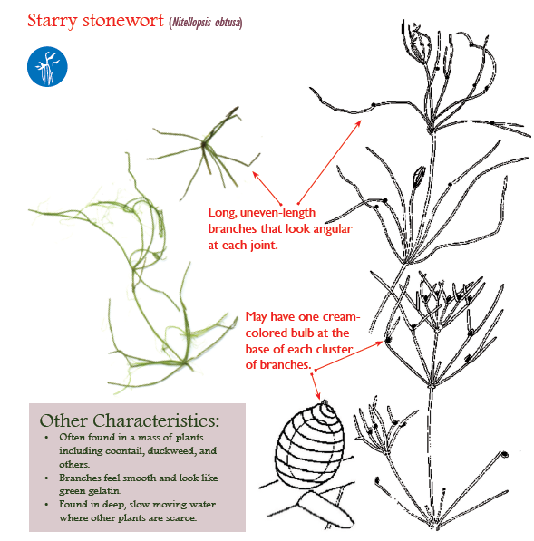
Starry Stonewort (Nitellopsis obtusa L.)
Native Range/ Introduction:
Europe, Western Asia/ Ballast Water
Ecological Threat:
An algae that forms dense mats of vegetation, that reduce biodiversity, Impedes movement of fish and other animals, and may decrease successful spawning activity of some fishes., Act as a substrate for zebra mussels, Cause negative impacts on benthic dwellers
Suggested Control:
Manual removal of plant and bulbs is possible but difficult.
Notes:
Native Range/Introduction:
Starry Stonewort is a species of large algae that is native to Europe and Western Asia and was likely introduced to North America in the Ballast water of ships. In 1978, it was found in the St. Lawrence River and in Lower South Bay of Oneida Lake in 2005.
Identification:
Starry Stonewort has long, variable-length, relatively straight branches arranged in whorls that attach at acute angles to stem nodes. It is light green when actively growing.
Impacts:
Starry stonewort forms dense mats of vegetation that completely cover lake bottoms. These mats decrease aquatic vegetative biodiversity and can lead to the accumulation of phytotoxins; furthermore they act as a favorite substrate for zebra mussels. Large populations of Starry stonewort may have negative impacts on native species that are dependent on lake bottom habitats, such as: minnows, logperch, darters, clams, and other invertebrates.
Spread:
Fragments of starry stonewort can be spread between lakes by boats, trailers, and anchors holding sediments. Local dispersal occurs by bulbils or fragments being transported by water currents or boats within the lake. Since only male starry stonewort exists in the U.S., no viable "seeds" are produced.
Control:
Manual removal of starry stonewort is possible, but difficult, and may be impractical on a large scale and requires the removal of bulbs to be successful. Herbicide applications may be less effective on tall stands of starry stonewort, as the chemical is quickly absorbed into the upper parts of the algae, leaving the lower parts unharmed. Chemical application requires permits.

Slide 20
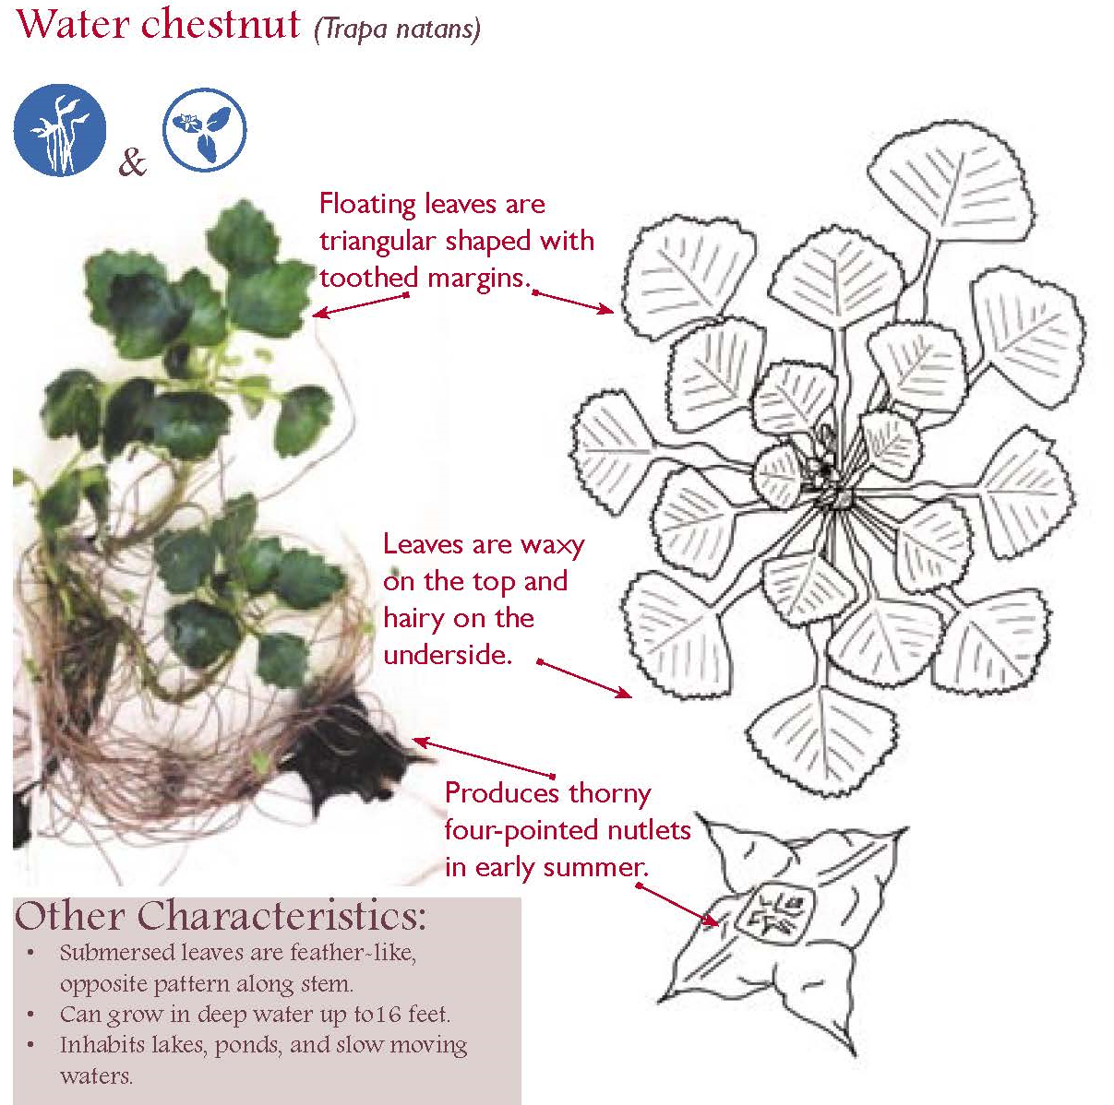
Water Chestnut (Trapa natans)
Native Range/Introduction
Western Europe, Northeast Asia & Africa/ accidental cultivation
Ecological Threat
Impenetrable mats that completely dominate surface water which alters water quality and clarity, Eliminates the growth of native aquatic plants, Makes boating, fishing, and swimming hazardous
Suggested Control:
Small populations controlled by hand pulling, Large populations controlled by mechanical harvesters or aquatic herbicides. Biological control agents are being explored
Notes:
Native Range/ Introduction:
Water chestnut is native to western Europe, Northeast Asia and Africa. Initial introduction to North America is thought to have occurred during the 1870’s through its’ cultivation in botanical gardens. From these gardens water chestnut is thought to have escaped and has since spread throughout the Great Lakes, and Finger Lakes, as well as, inland lakes and waterbodies throughout the north eastern part of North America and Quebec.
Identification:
water chestnut is an aquatic plant that bears a rosette of floating leaves at the tip of a submersed and rooted stem. Although it grows best in shallow, nutrient-rich lakes and rivers, it can also grow on wet, mucky substrates. (Note that this is not the same species used in Asian cooking).
The name water chestnut refers to the plant’s characteristic fruit which have a nut-like structure segmented into 4 distinct sections, they are about an inch wide and are a greenish-brown color when maturing and black when no longer viable. Each seed can produce 10 – 15 new plants; in turn, each rosette can produce 15 – 20 seeds. Seeds are easily dispersed in water and can remain viable in sediment for 12 years. Unviable nuts turn black and can float to shorelines where they can cause injury to unsuspecting beach goers.
Impacts
This fast-growing, aquatic plant forms large mats that shade out native aquatic vegetation and has the ability to completely dominate surface waters. It reduces oxygen levels for fish and encourages sedimentation by restricting silt movement.
Spread:
Water chestnut is easily spread by plant fragmentation and by seed.
Control: Can be removed mechanically, by hand; A commonly used herbicide is Clear Cast. A number of potential biological control agents were found in field surveys. The most promising biocontrol species appeared to be the leaf beetle Galerucella, the potential of subspecies within this genus as a control agent are currently being researched.

Slide 21
What should a steward do when observing water and hitchhiking organisms/debris?
If you discover an aquatic species that you cannot identify or you suspect may be an invasive species, follow AIS identification and specimen collection protocols as designated and refer the boater to additional Clean~Drain~Dry materials.

Slide 22
Specimen Collection Approach
Obtain Positive ID of Organisms: document the organism- photograph or draw, where it was found and size
Send photo to designated contact (lake association president, PRISM coordinator, etc.) and send sample if requested
Notes:
In general, a “bag and tag” specimen collection approach is followed:
• Using the provided waterproof permanent marker, write the date; time; collector’s name and contact information, name of waterbody, name of launch site or, if the specimen is found aboard a boat, the boat name; and any ID numbering/lettering system your program uses on a ziplock bag provided as part of your steward supplies.
• Follow your program instructions for placing and sealing specimen in bag for delivery for identification. Keep it cool per your program instructions.
• Follow your program’s specimen delivery and reporting protocol developed for:
• Where the specimen goes
• How the specimen gets there
• Who (contact information) will receive the specimen, and
• How the expert notifies the program (steward, coordinator, both, etc.) of specimen identification results.
• Update data records and iMapInvasives.org database when results are received

Slide 23
Specimen Collection Approach
“Bag and Tag” specimen collection approach is followed:
Using the provided waterproof permanent marker, write the date; time; steward name and contact information, name of waterbody, name of launch site on a Ziploc bag provided as part of your steward supplies.
Place sample in bag with moist paper towel, double bag if necessary
Submit “Bag and Tag” collection to coordinator
Update data records and iMapInvasives.org database when results are received
Notes:
In general, a “bag and tag” specimen collection approach is followed:
• Using the provided waterproof permanent marker, write the date; time; collector’s name and contact information, name of waterbody, name of launch site or, if the specimen is found aboard a boat, the boat name; and any ID numbering/lettering system your program uses on a ziplock bag provided as part of your steward supplies.
• Follow your program instructions for placing and sealing specimen in bag for delivery for identification. Keep it cool per your program instructions.
• Follow your program’s specimen delivery and reporting protocol developed for:
• Where the specimen goes
• How the specimen gets there
• Who (contact information) will receive the specimen, and
• How the expert notifies the program (steward, coordinator, both, etc.) of specimen identification results.
• Update data records and iMapInvasives.org database when results are received

Slide 24
Additional Field Guides and Resources
iMapInvasives [website]
New York Invasive Species Information [website]
Northeast Aquatic Nuisance Species Panel Online Guide [website]
Partnership for Regional Invasive Species Management Websites:
  Adirondack Park Invasive Plant Program [APIPP]
  Capital/Mohawk [CapMo PRISM]
  Catskill Regional Invasive Species Partnership [CRISP]
  Finger Lakes [FL PRISM]
  Lower Hudson [LH-PRISM]
  Long Island Invasive Species Management Area [LIISMA]
  St. Lawrence Eastern Lake Ontario [SLELO PRISM]
  Western New York [WNY PRISM]
  Please see Section #7 AIS Resources & References in your
  NYS Watercraft Inspection Steward Program Handbook.

